Slide 1

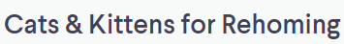
Web Scraping Project
Example - Kijiji
June 2022
Credits: Balifilm/ Shutterstock.com
Photo credits: Kijiji and Pusha The Cat

Slide 2








Agenda
Motivation
Data: Web Scraping and Cleaning
Data Analysis
Conclusions
Challenges
Next Steps
Photo credits: Kijiji

Slide 3
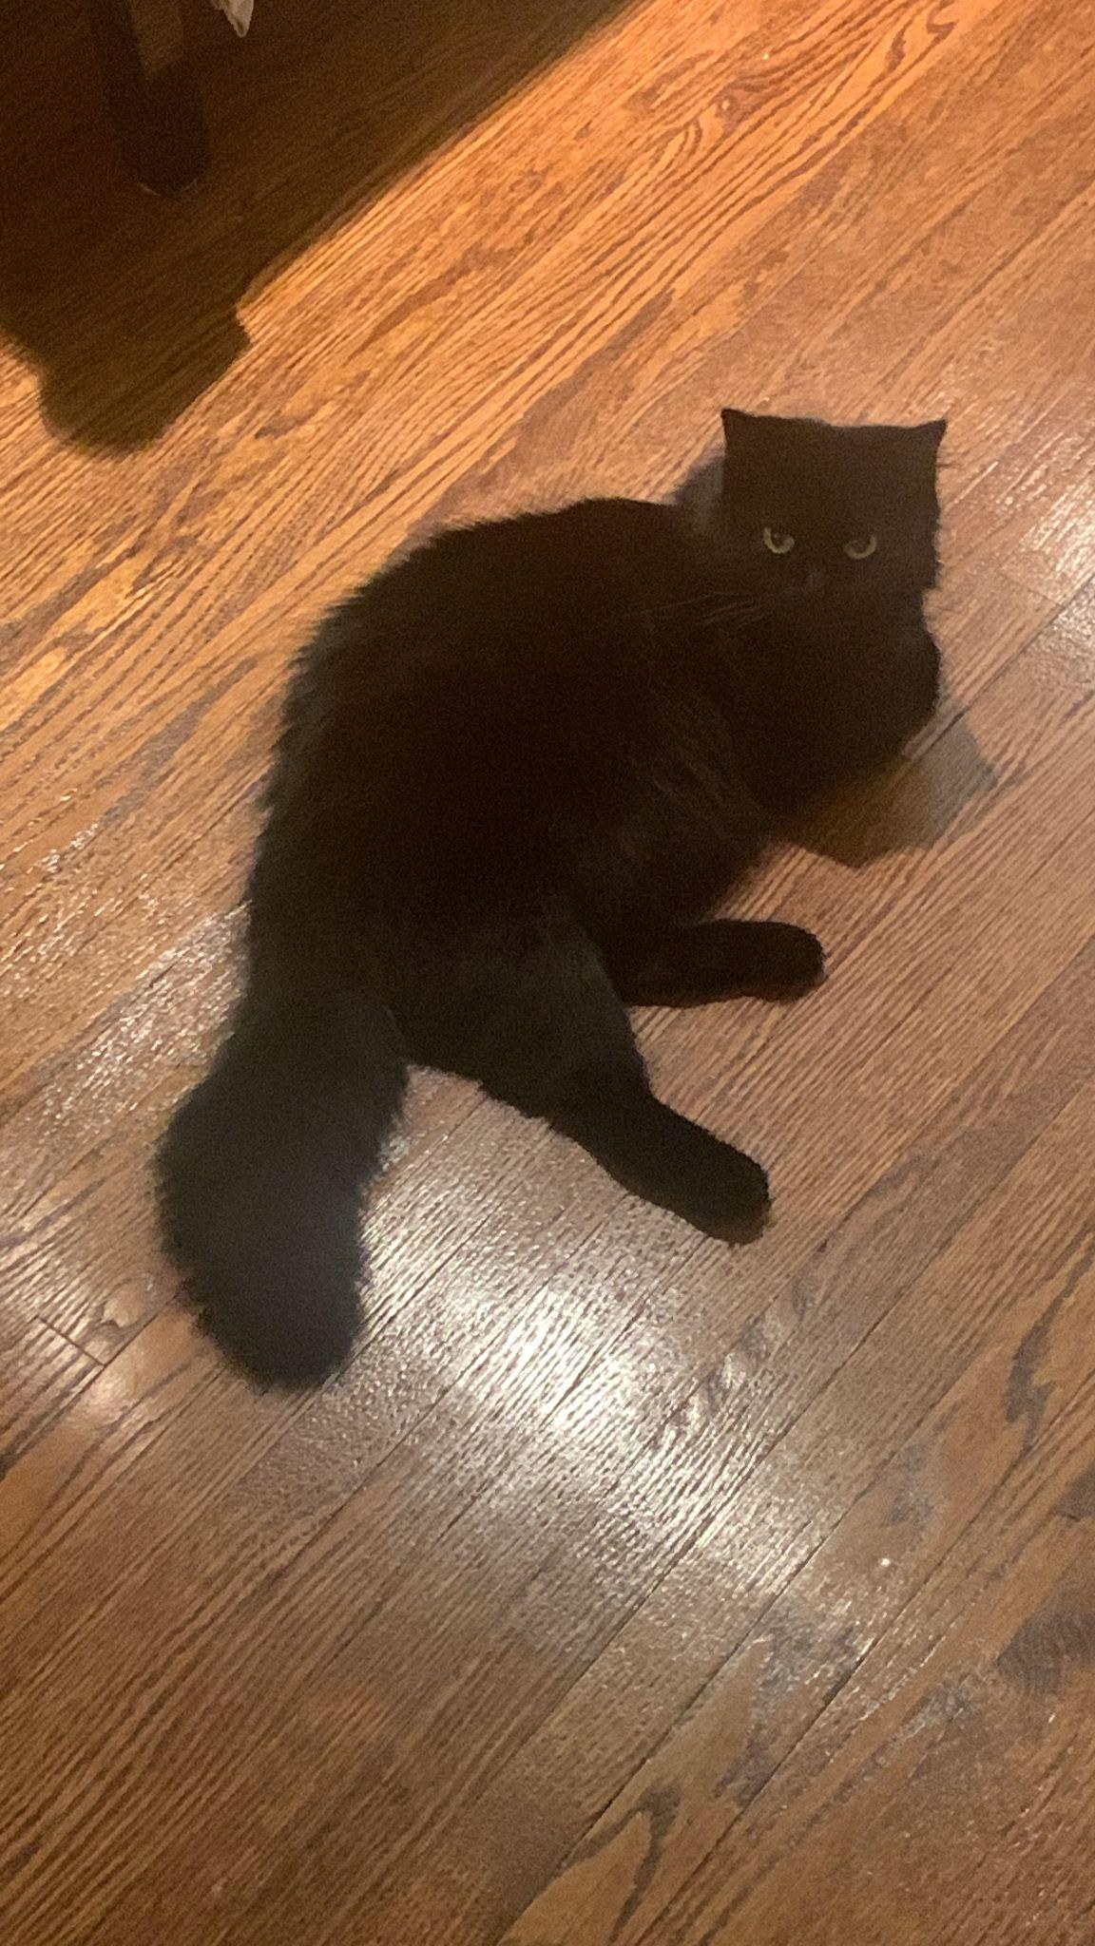

Motivation
Are you looking at other cats on the Internet?
How dare you?
I have a cat
Photo credits: Pusha The Cat

Slide 4
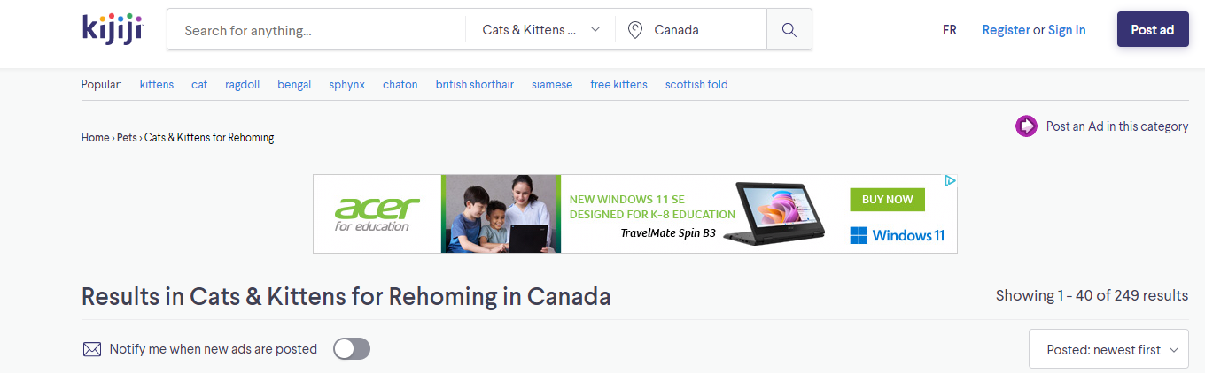
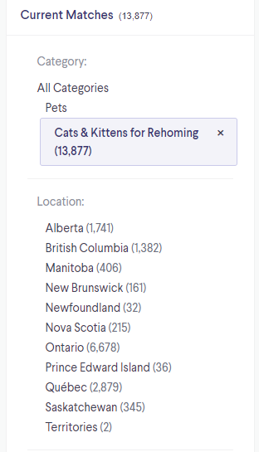
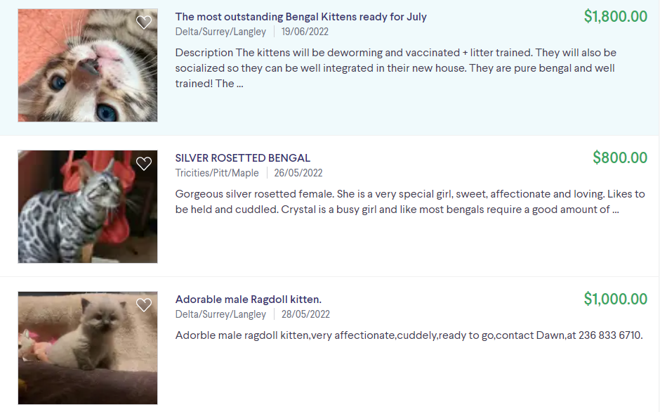
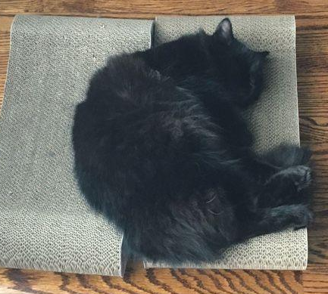
Website
I see you

Slide 5
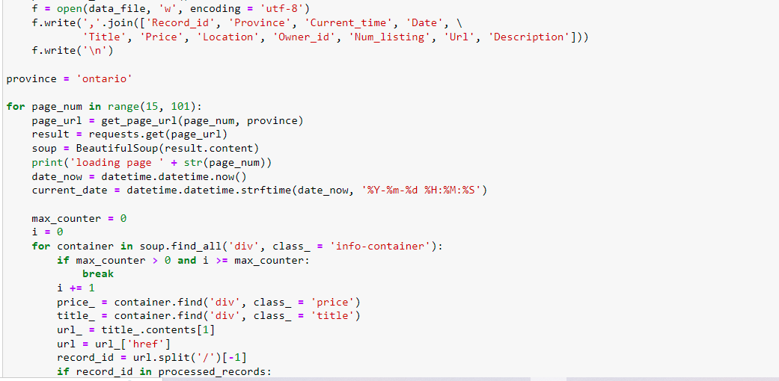
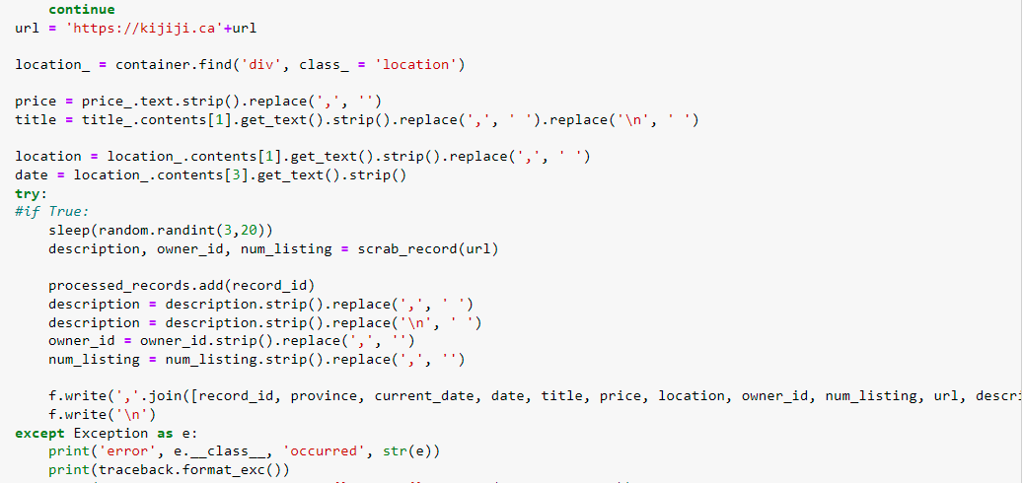
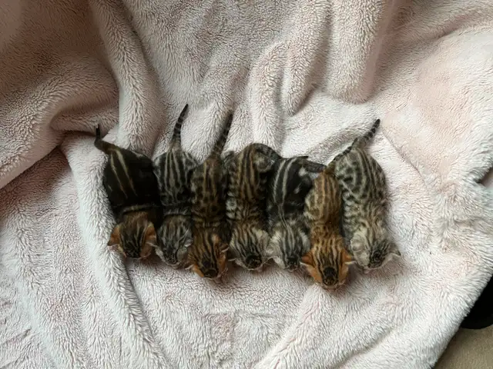
Scraping Process
Selenium was used to download a separate page for every listing. Then, BeautifulSoup scraped the data from the page;
Scraping process was going province by province;
Approximately, 5% of ads failed to scrap (Error message is below)
Scraping Code Fragments
Photo credits: Kijiji

Slide 6
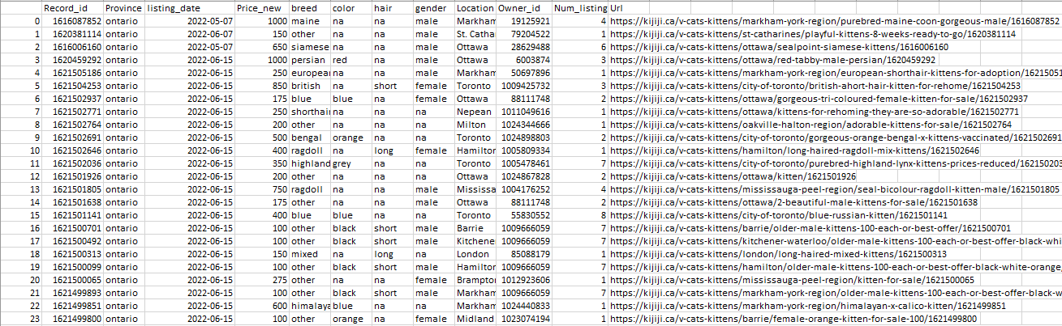

Data Cleaning
Special code for data cleaning was created
Breed, color, hair and gender data were extracted from both ad’s title and description
Total data record: 3,354 rows
Listings from Quebec were excluded from analysis
Clean Data Sample
Photo credits: Kijiji

Slide 7
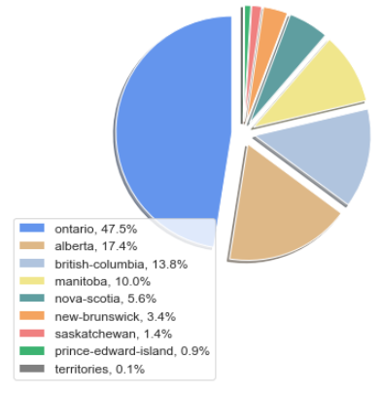
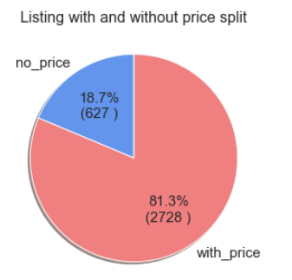
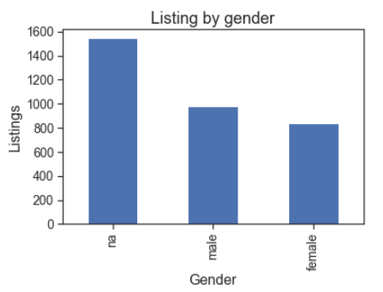
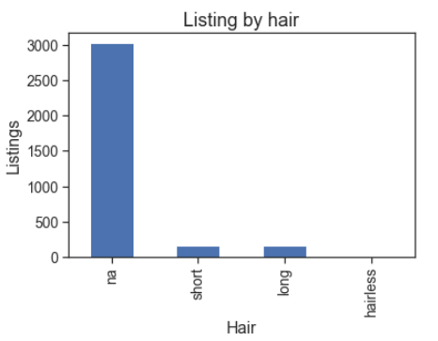

Data Analysis: Basic Statistics
Photo credits: Kijiji

Slide 8
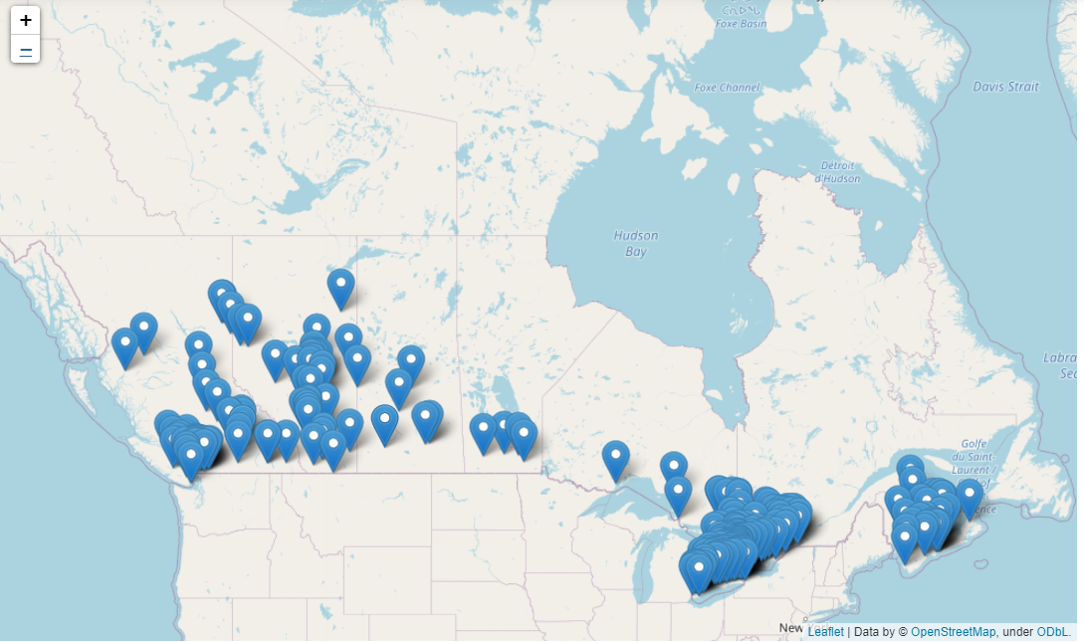
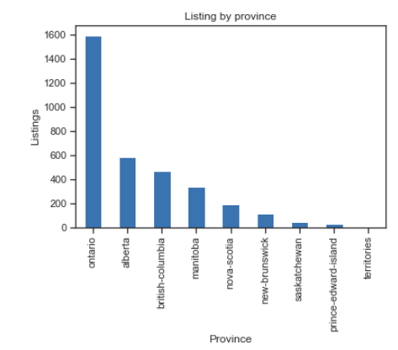
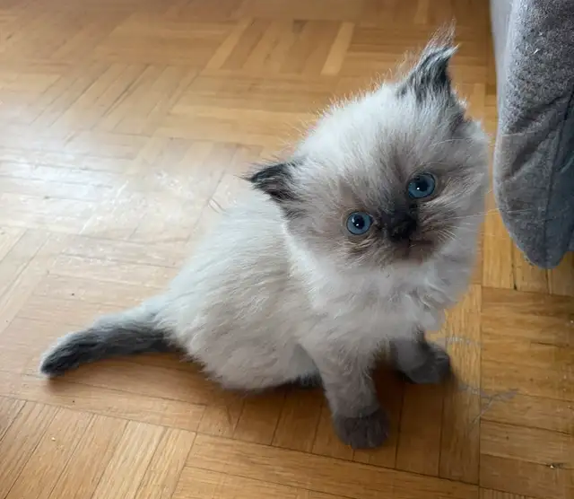
Data Analysis: Geo Distribution
Photo credits: Kijiji

Slide 9
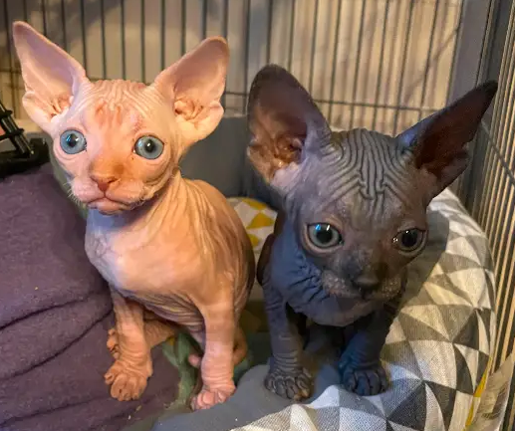
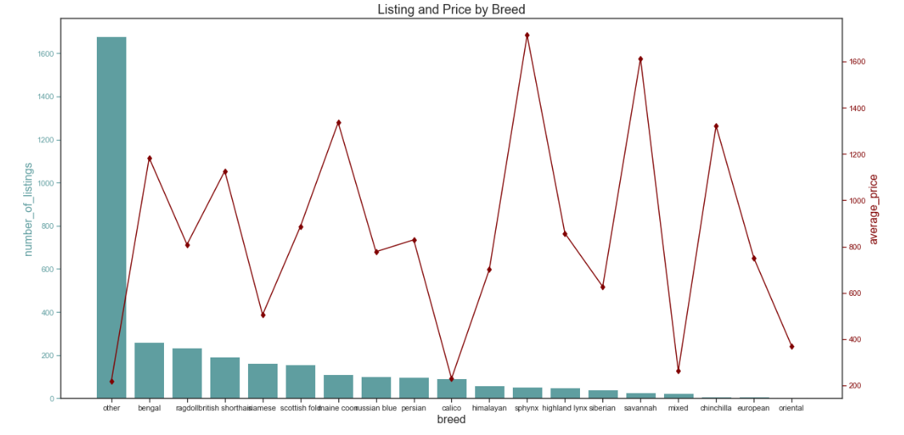
Data Analysis: Breed Analysis
Photo credits: Kijiji

Slide 10

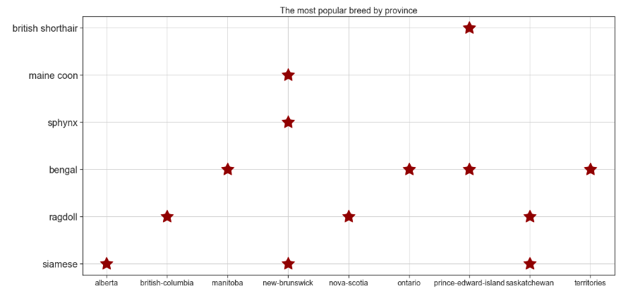
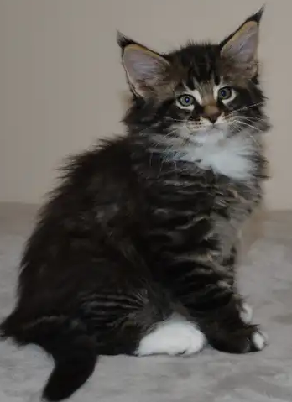

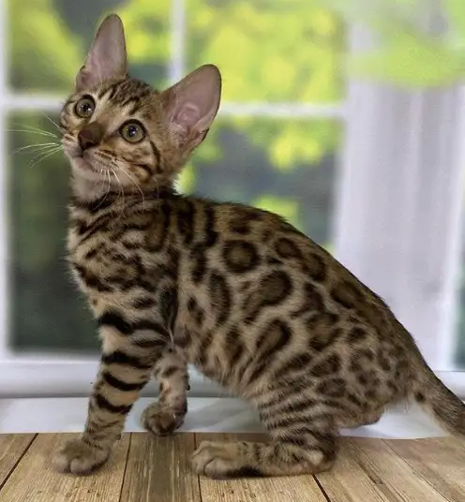

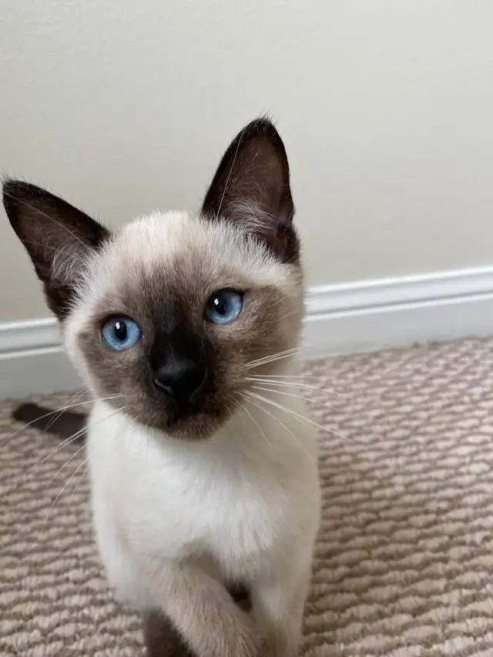
Data Analysis: Breed Analysis
Photo credits: Kijiji
Note: excluding Others and Mix

Slide 11

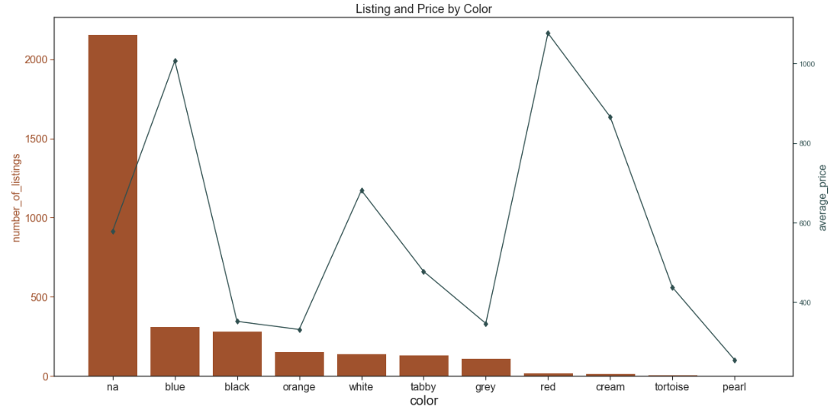
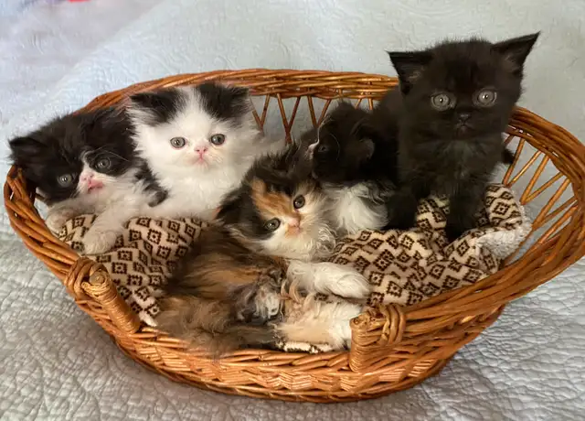
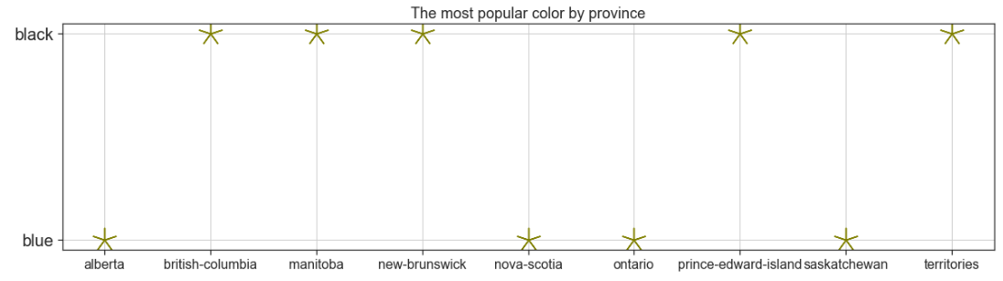
Data Analysis: Color Analysis
Photo credits: Kijiji

Slide 12
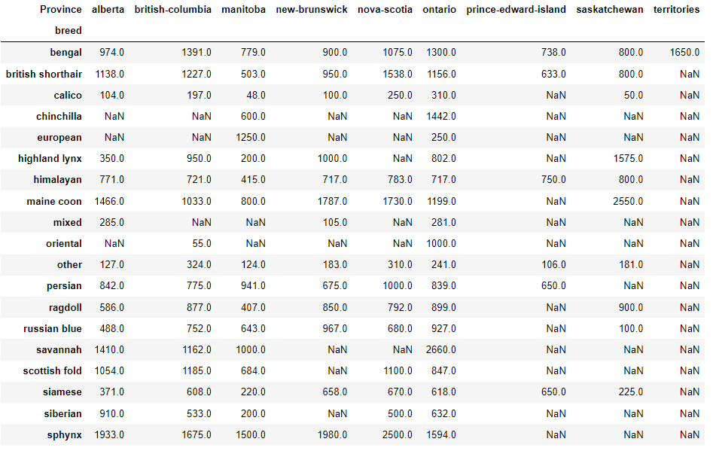
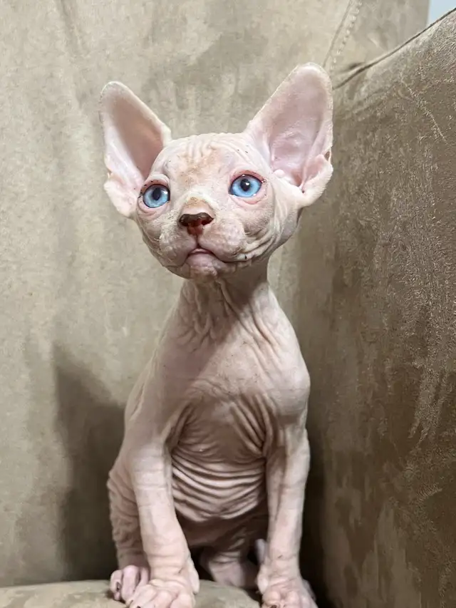
Interesting Findings and Conclusions
Approximately half of the listings propose non-pedigree kittens
Half of the listings accounts for Ontario
Sphynx kittens are the most expensive across all data, however, in different provinces different breeds are the most expensive
Black kittens are one of the cheapest compared to other colors, and that is one of the most popular colors
Photo credits: Kijiji

Slide 13
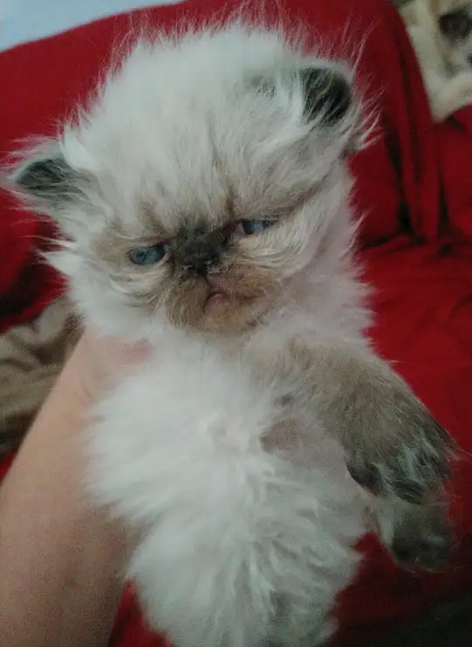
Challenges
The scraping code took some time; the exact reason of mistake is not 100% clear and needs further investigation
Kijiji does not provide separate fields for breed/color/gender, so this information has to be extracted from the plain text of title and/or description
Data cleaning process was quite long
Listings from Quebec should be processed separately (first, French; second, different price format)
Data analysis using Pandas
Getting latitude and longitude using Nominatim geocoder took some time
Visualization using different libraries and functions
Photo credits: Kijiji

Slide 14

Next Steps
Include listings from Quebec
More meticulous analysis of the title and description (probably, url) to get breed/gender/color more accurate
Seasonal analysis with long term time series data (seasons, holidays, etc.)
Create a pricing model to predict price based on the location, breed, color, gender, age, etc.
Photo credits: Kijiji

